Slide 1

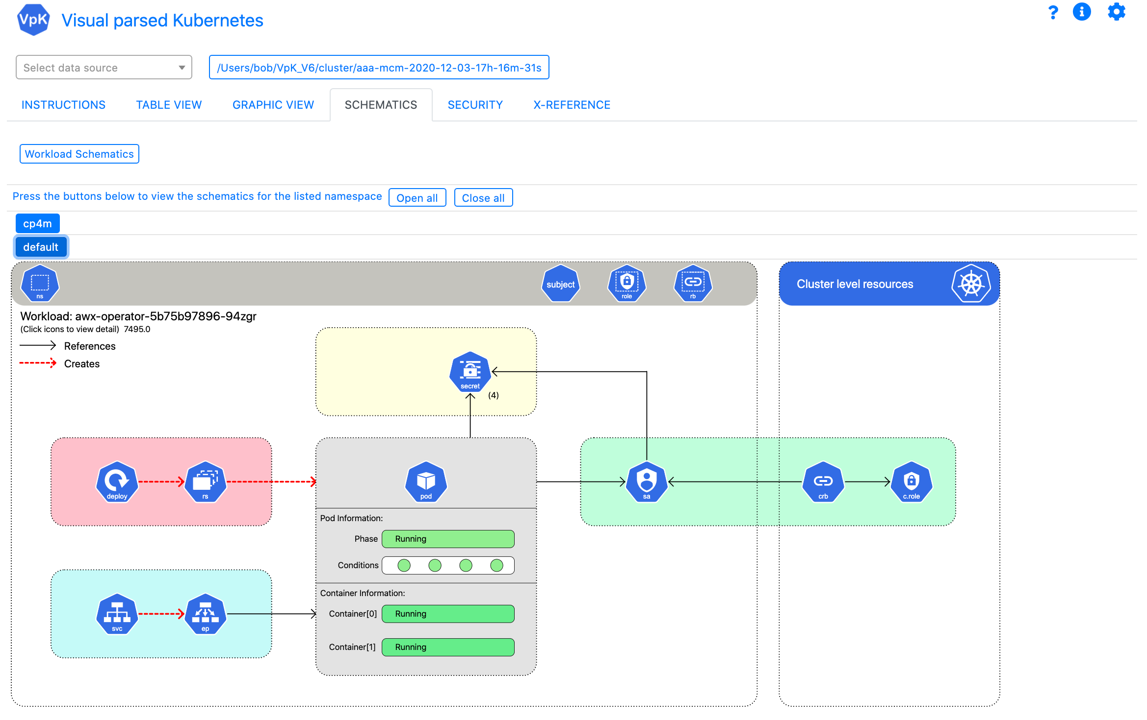
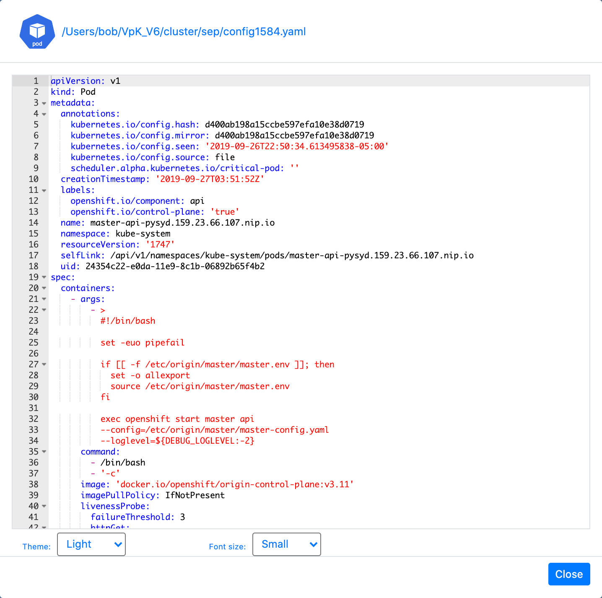
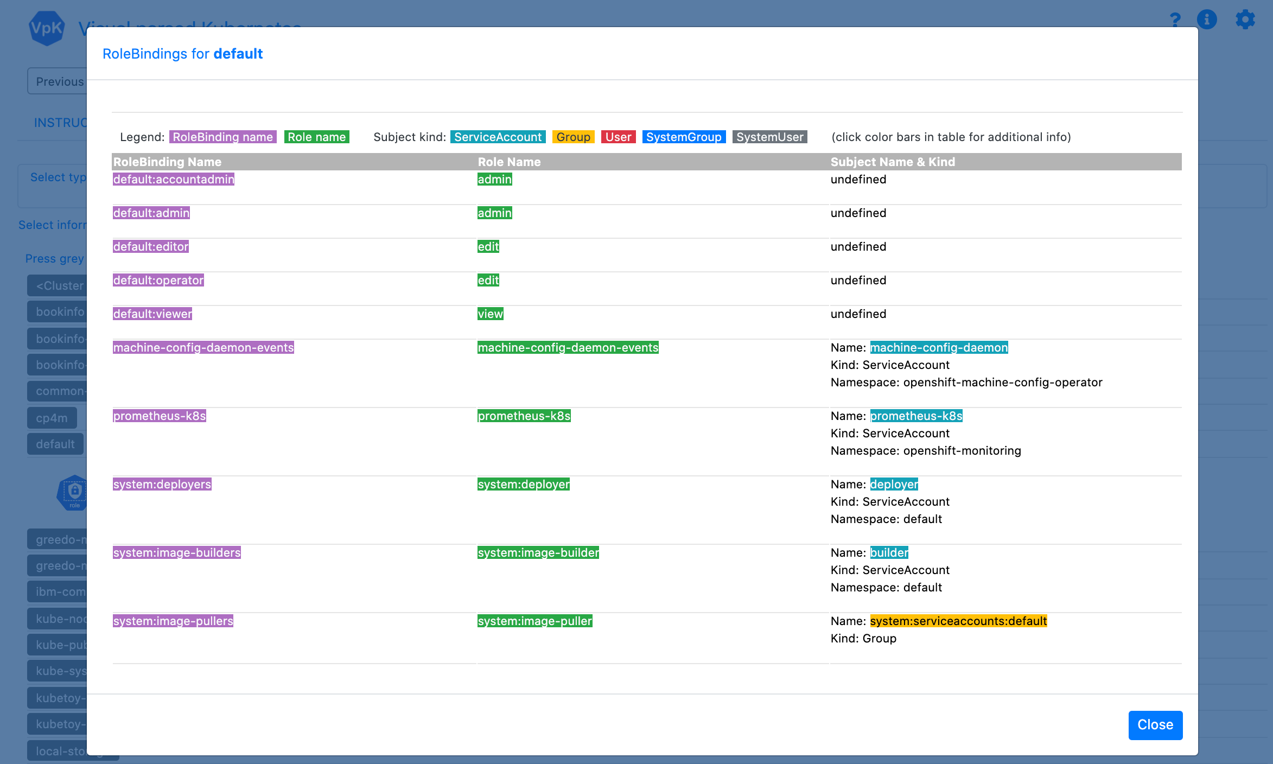
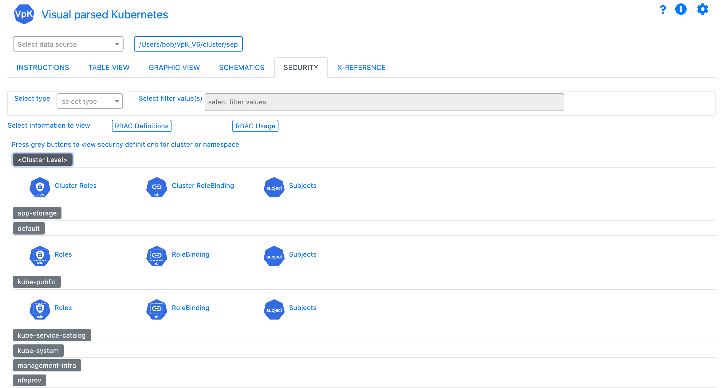
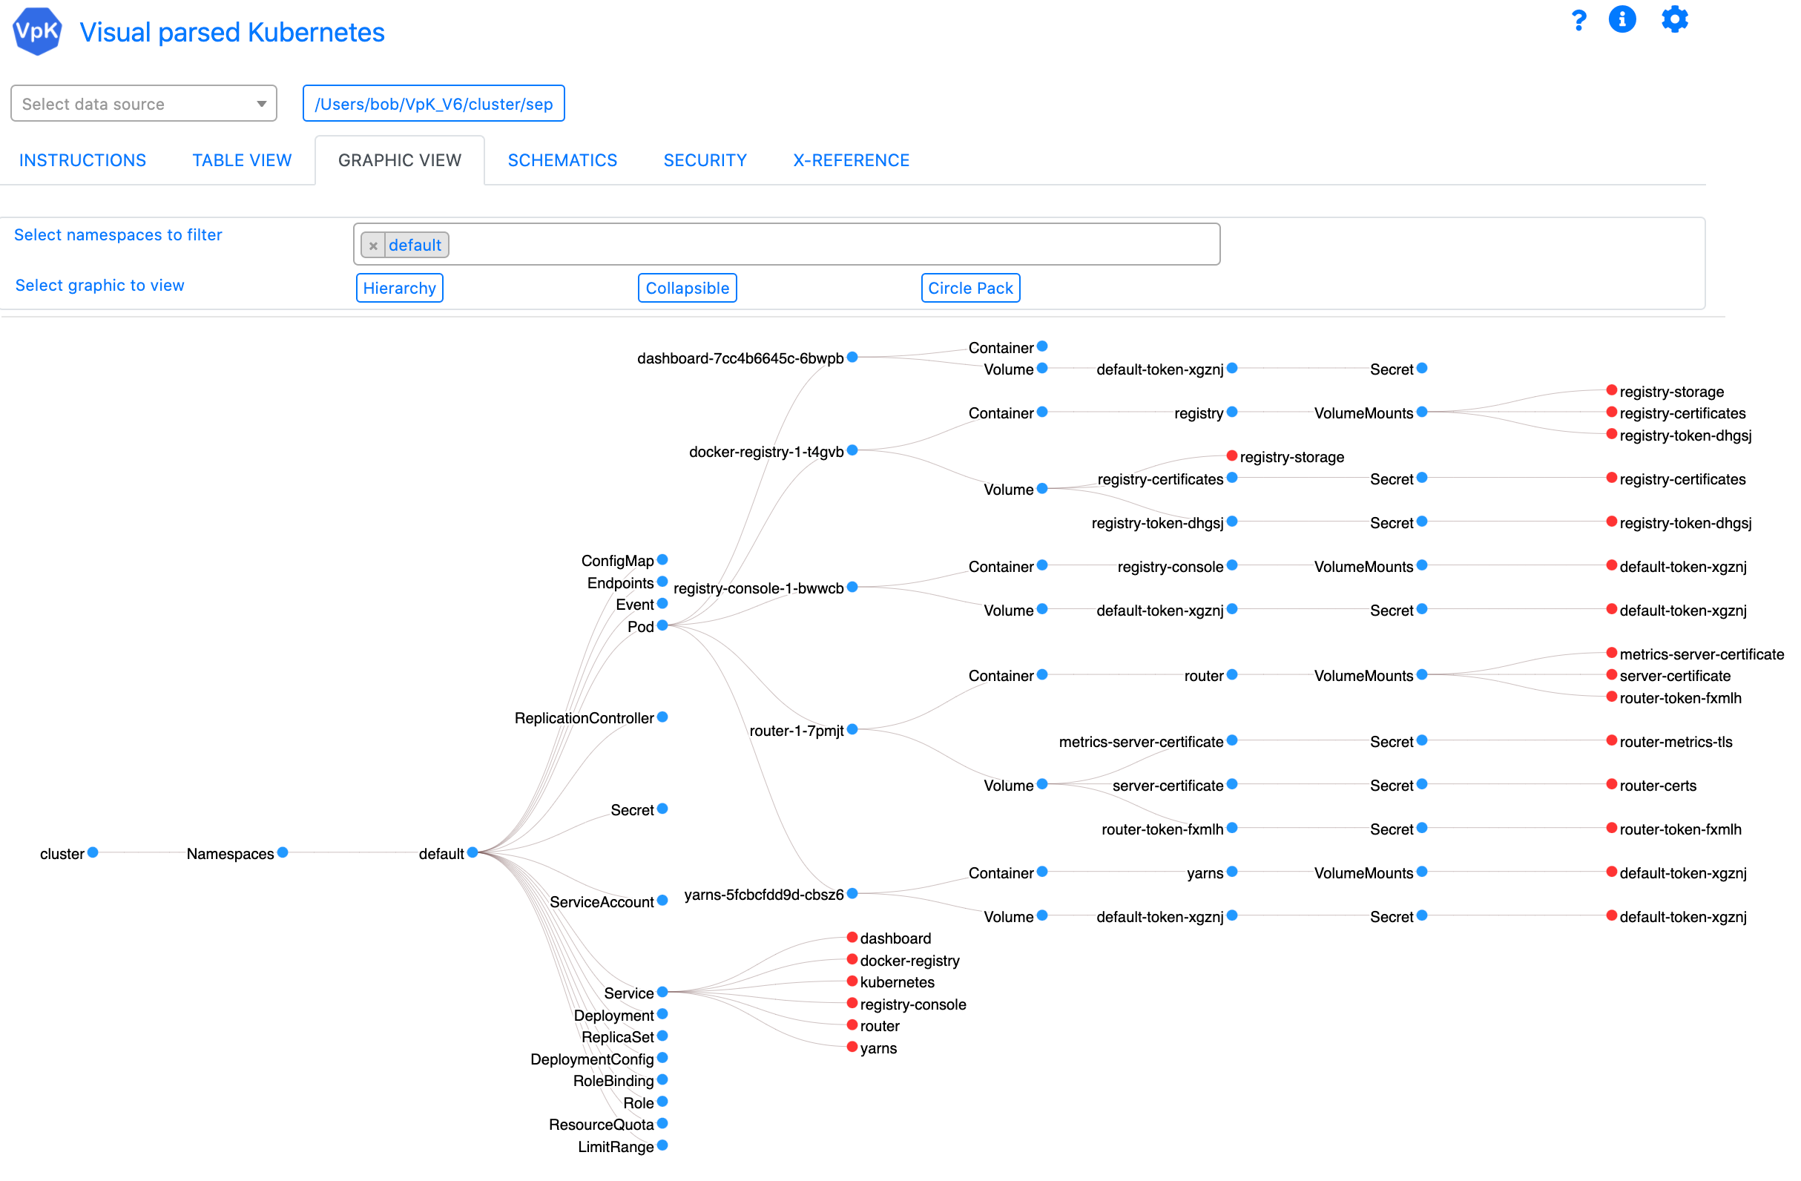
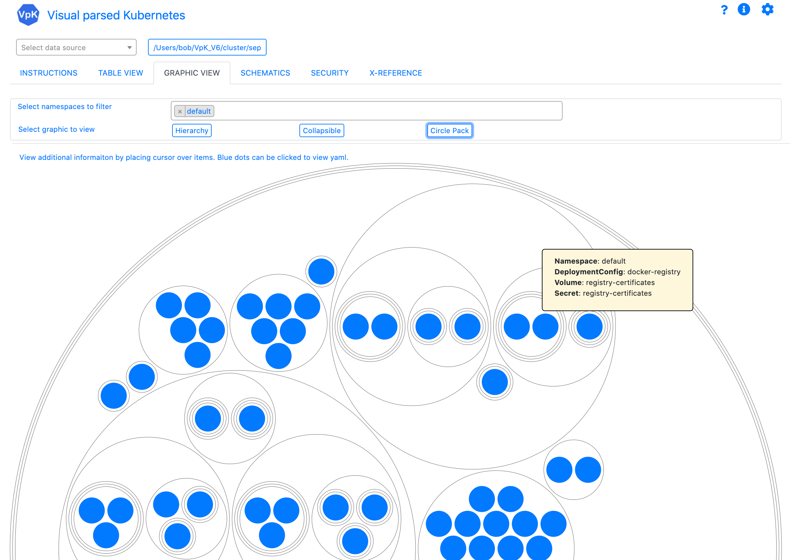
VpK Training
Overview

Slide 2
VpK
Visual parsed Kubernetes

Slide 3



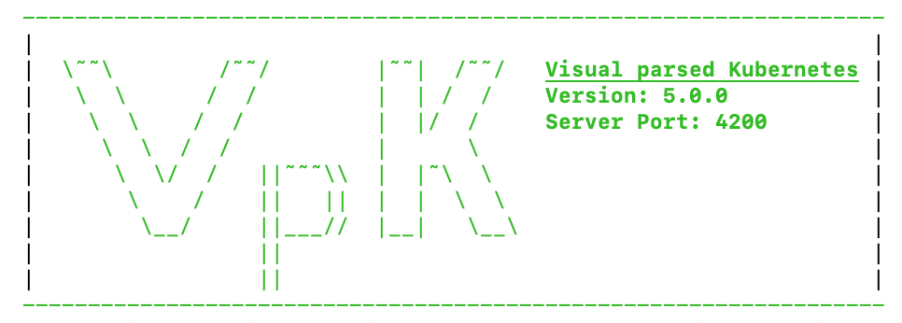

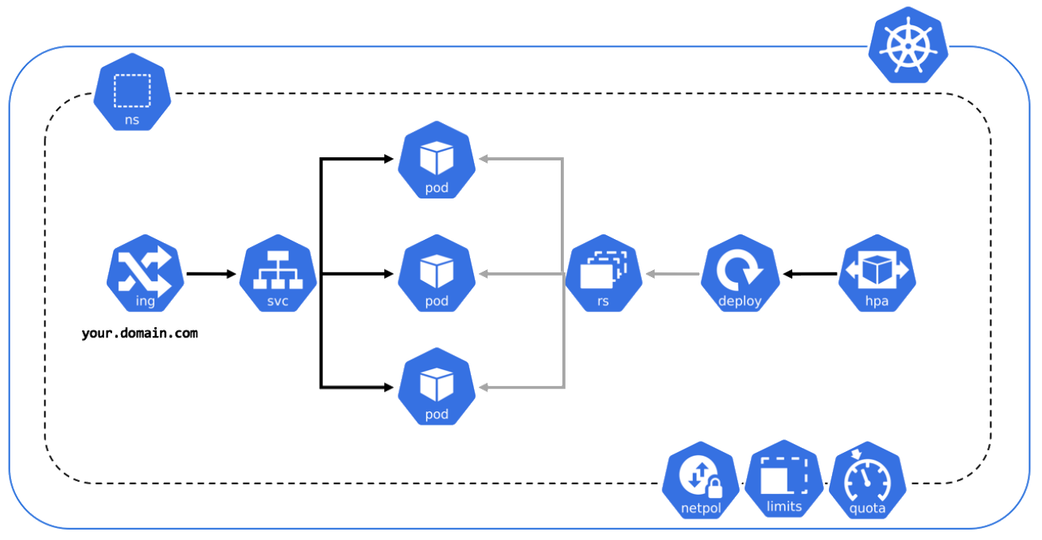

Overview
Visual parsed Kubernetes
Kubernetes
Application UI
Laptop

Slide 4
Overview
VpK is designed to capture a point-in-time snapshot of the cluster.
Vpk provides the ability to view the captured snapshot in a disconnected fashion. Once the snapshot is created the user no longer needs to be connected to the cluster.
Vpk will not modify a cluster. It is designed as read-only.
VpK is not a real time monitoring tool.

Slide 5
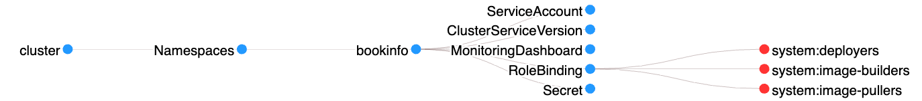
General usage, “click it”
If you see an icon, click it.
If you see text with colored background, click it.
If you see a blue dot or red dot in a graphic, click it.
If you see resource name in a table, click it.

Slide 6
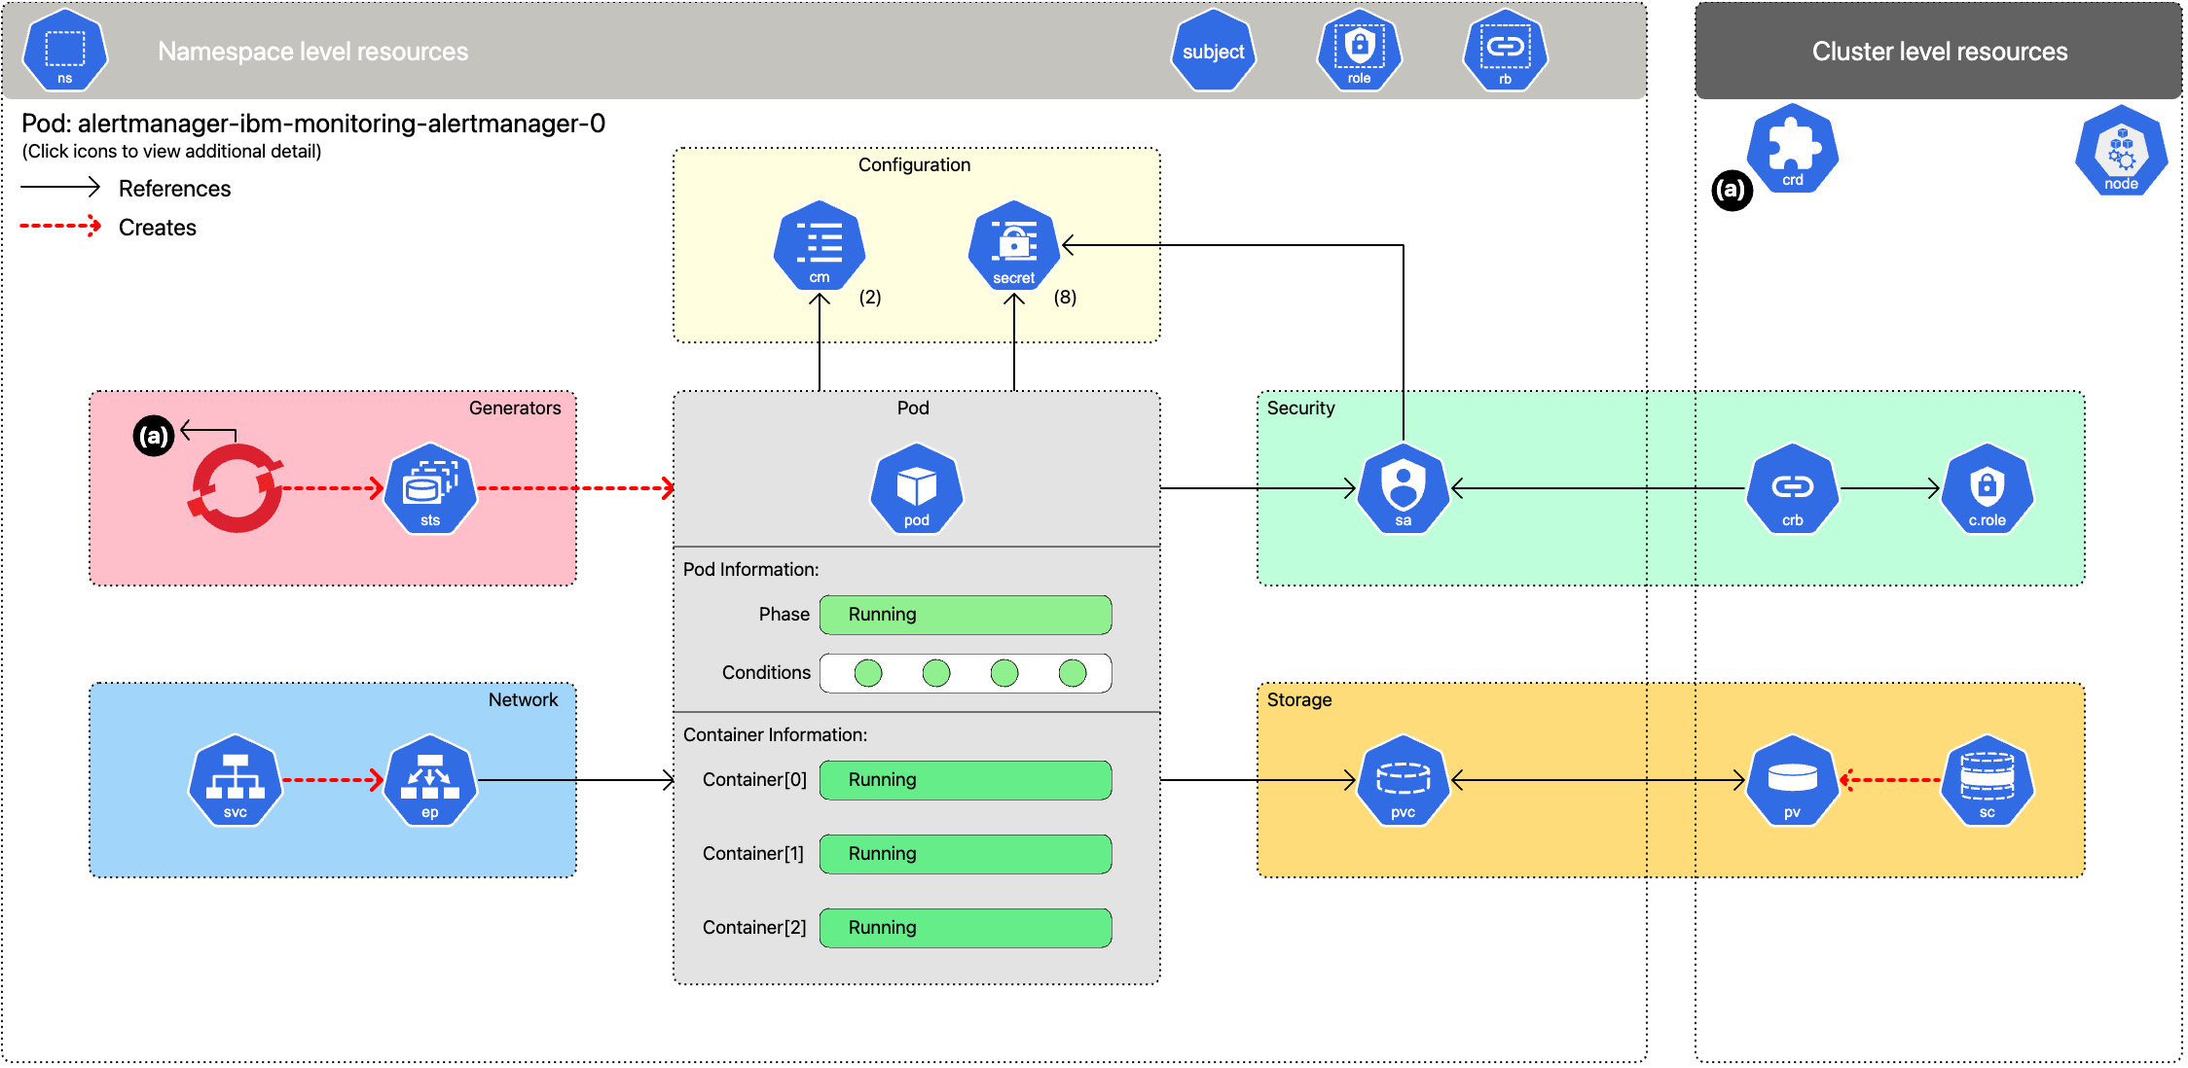
Interactive schematic of deployed workload

Slide 7
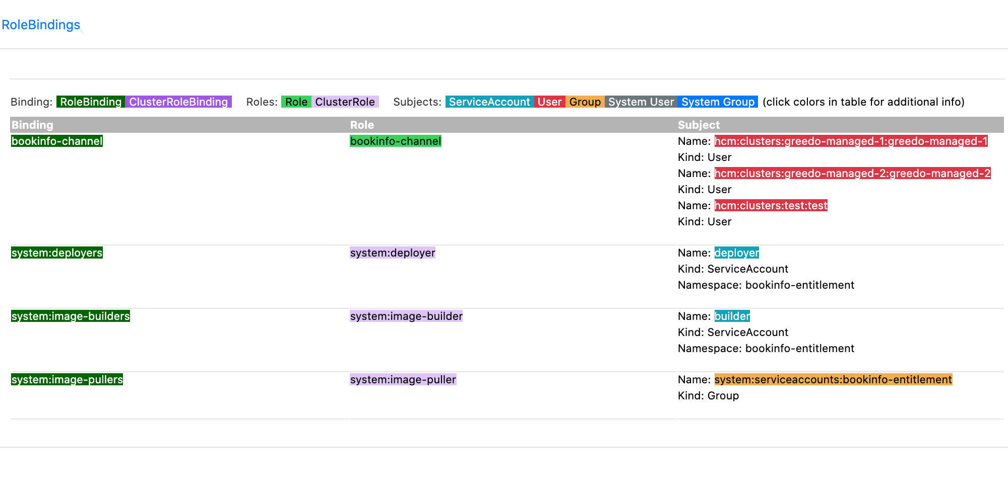
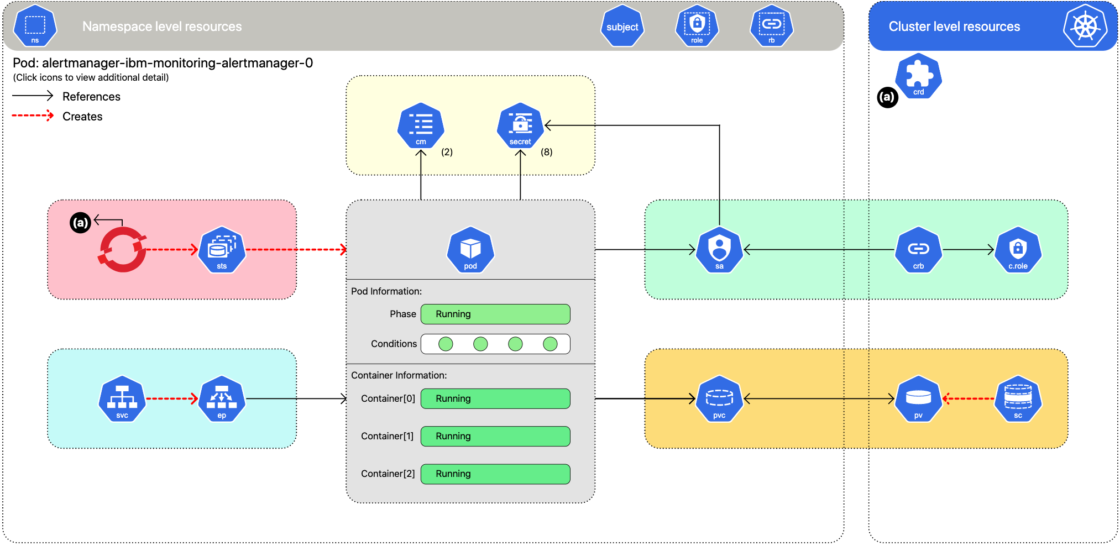
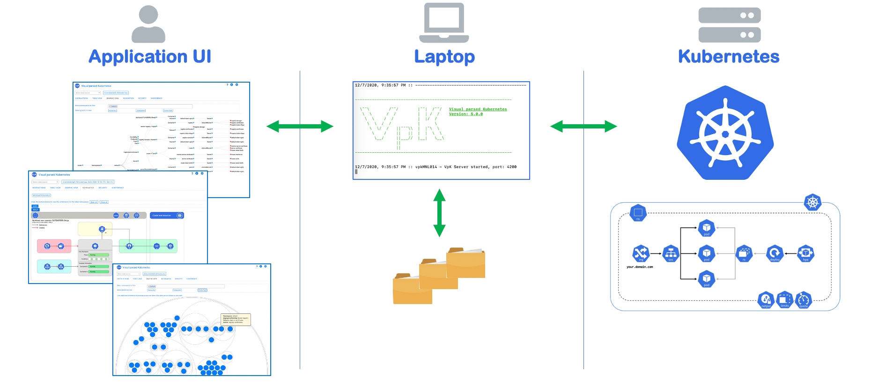
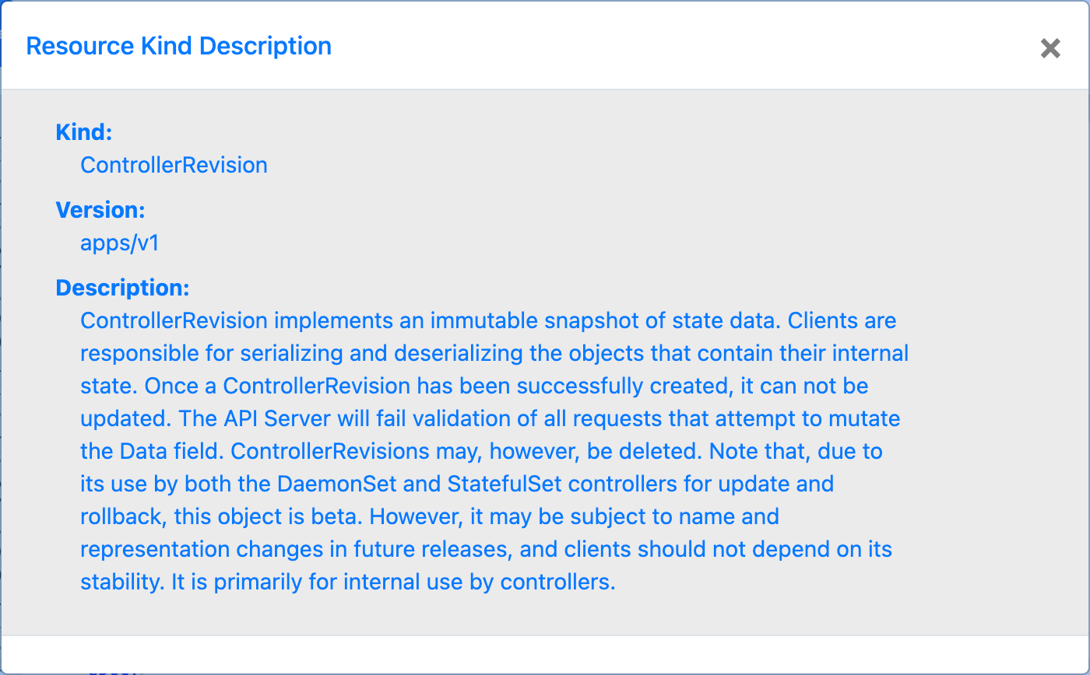
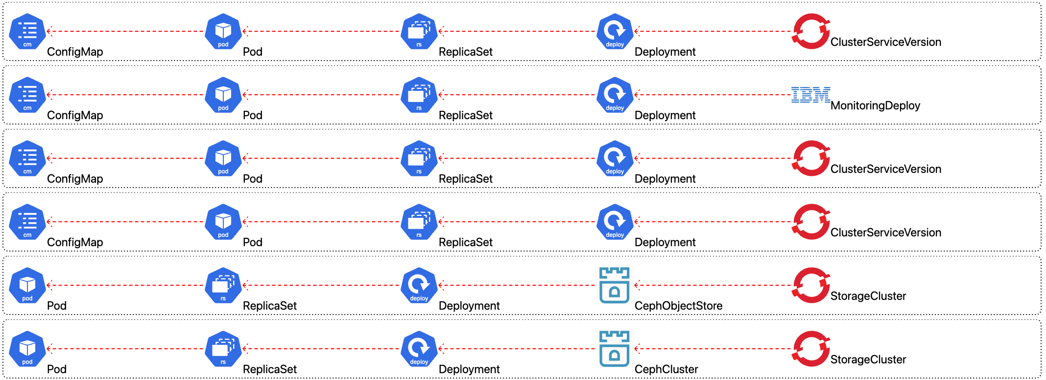
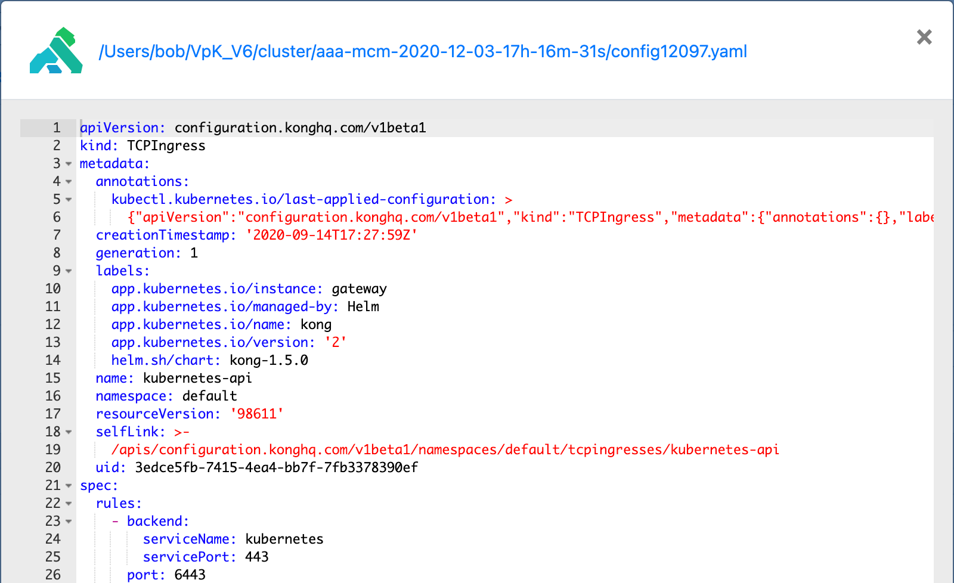
RBAC info, view yaml, ownerRefs, descriptions
OwnerReference chains
Resource description
Color coded views of RBAC
View resource yaml

Slide 8
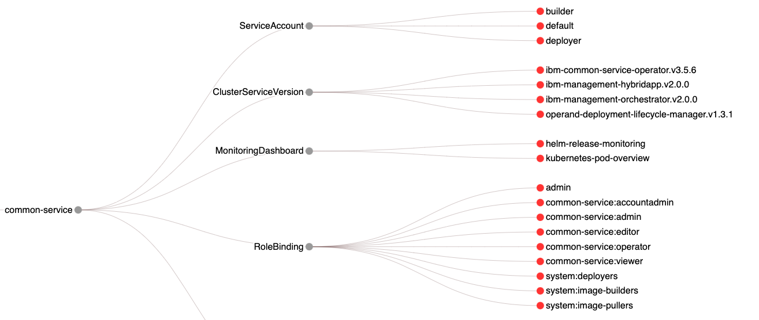
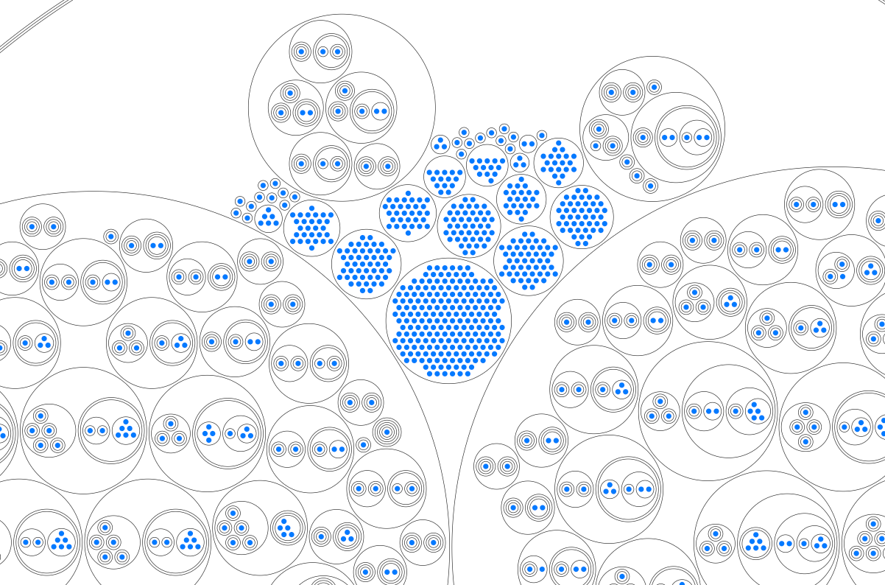
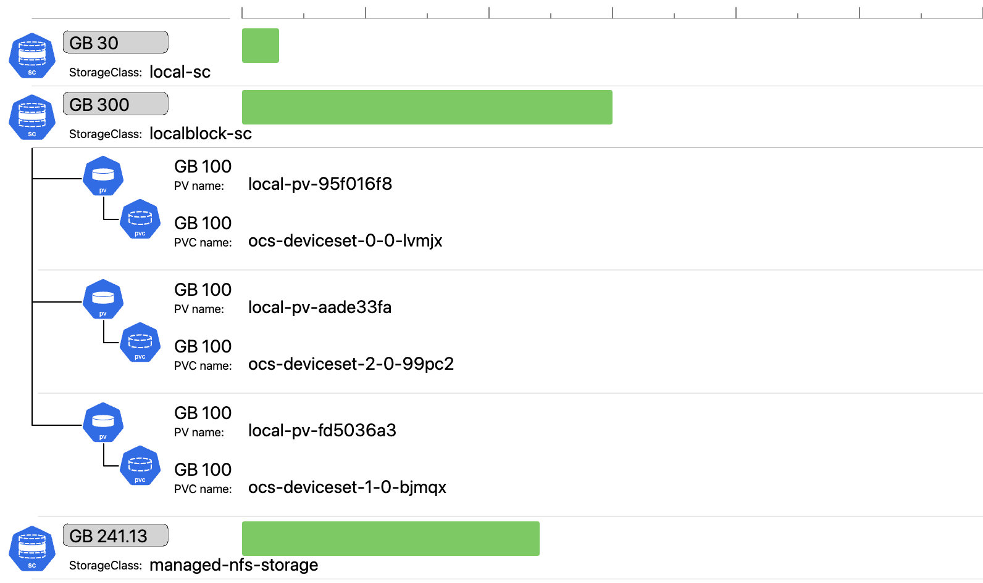
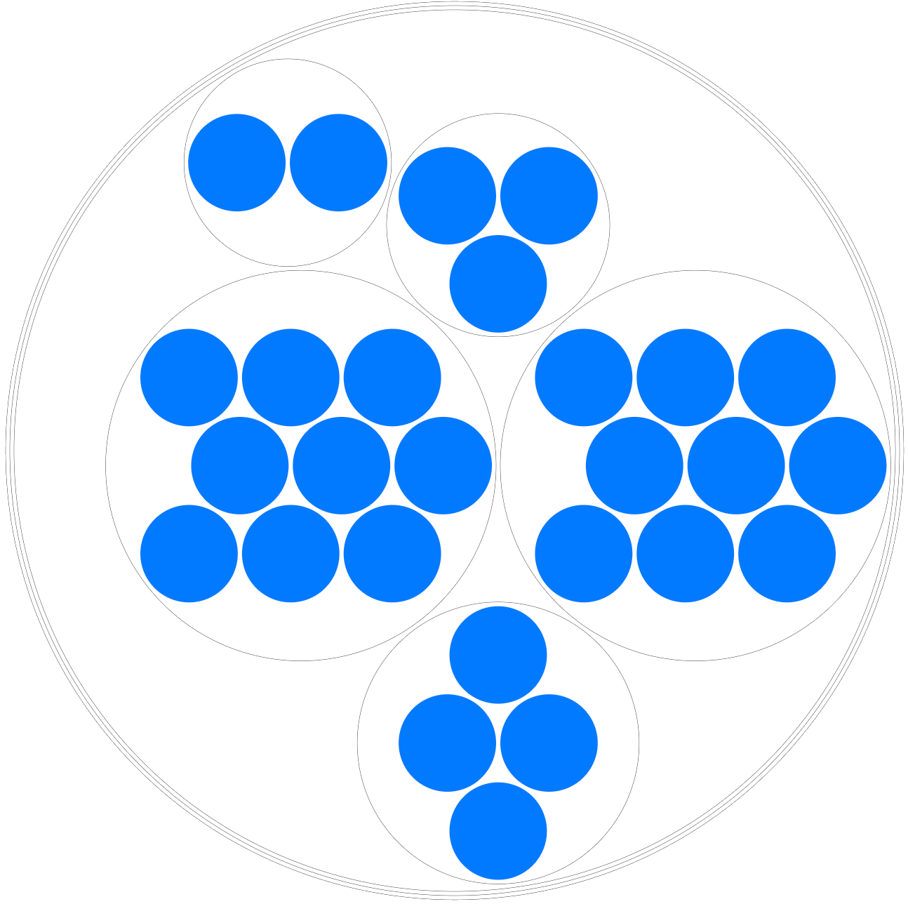
Multiple graphics of K8 resources
Hierarchy diagrams
CirclePack Diagrams
Drill-down
Bar charts

Slide 9
Getting started
VpK software is open source and free.
Vpk requires node.js along with package manager npm or yarn.
VpK software is available from https://github.com/k8debug/vpk.git Clone the repo or download the zip. If using zip file, unzip file into a directory.
Change to the directory where the software is cloned or copied and install the required node packages by running: npm install
Start the software by running command: npm start

Slide 10




Visual parsed Kubernetes
“Visualizing what’s inside of Kubernetes”
VpK software: Open source and free, available at: https://github.com/k8debug/vpk
Music: Creative Minds from Bensound.com"
Icons: In displaying resources icons are used to help identify the resource. These icons are the properties of the associated companies or organizations:
Red Hat, Inc.
IBM, Inc.
The Linux Foundation
Any errors or omissions in providing attribution are merely an accident and to not imply any ownership.

Slide 11
Visual parsed Kubernetes
“Visualizing what’s inside of Kubernetes”
Interactive schematic of
deployed workload

Slide 12
VpK
Visual parsed Kubernetes
“Visualizing what’s inside of Kubernetes”
Custom cross references, x-refs

Slide 13
VpK
Visual parsed Kubernetes
“Visualizing what’s inside of Kubernetes”

